Slide 1
Module3_Part11 Textbook : Operating Systems Concepts by Silberschatz
Operating SYSTEMS

Slide 2
Resource-Allocation-Graph Algorithm
If we have a resource-allocation system with only one instance of each resource type, we can use a resource-allocation graph for deadlock avoidance.
In addition to the request and assignment edges already described, we introduce a new type of edge, called a claim edge.
A claim edge Pi -> Rj indicates that process Pi may request resource Rj at
some time in the future. This edge resembles a request edge in direction but is
represented in the graph by a dashed line.
When process Pi requests resource Rj, the claim edge Pi → Rj is converted to a request edge. Similarly, when a resource Rj is released by Pi, the assignment edge
Rj -> Pi is reconverted to a claim edge Pi → Rj.

Slide 3
Resource-Allocation-Graph Algorithm
We note that the resources must be claimed a priori in the system.
That is, before process Pi starts executing, all its claim edges must already appear in the resource-allocation graph.
Now suppose that process Pi requests resource Rj. The request can be granted only if converting the request edge Pi → Rj to an assignment edge R1 → Pi does not result in the formation of a cycle in the resource-allocation graph.
We check for safety by using a cycle-detection algorithm.
If no cycle exists,
then the allocation of the resource will leave the system in a safe state.
If a cycle is found,
then the allocation will put the system in an unsafe state. In that case, process Pi will
have to wait for its requests to be satisfied.

Slide 4
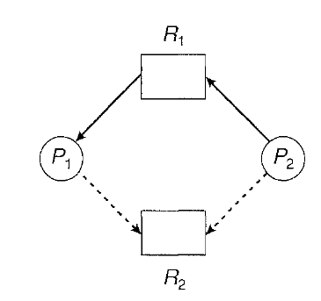
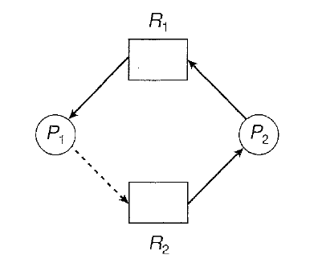
Resource-Allocation-Graph Algorithm
a
b
Consider the resource-allocation graph ‘a’ . Suppose that P2 requests R2 . Although R2 is currently free, we cannot allocate it to P2, since this action will create a cycle in the graph b. A cycle, as mentioned, indicates that the system is in an unsafe state. If P1 requests R2, and P2 requests R1, then a deadlock will occur.

Slide 5
Banker’s Algorithm
The resource-allocation-graph algorithm is not applicable to a resource allocation
system with multiple instances of each resource type.
We can use an algorithm commonly known as the banker's algorithm.
When a new process enters the system, it must declare the maximum number of instances of each resource type that it may need.
This number may not exceed the total number of resources in the system.
When a user requests a set of resources, the system must determine whether the allocation of these resources will leave the system in a safe state.
If it will, the resources are allocated; otherwise, the process must wait until some other process releases enough resources.

Slide 6
Banker’s Algorithm
Several data structures must be maintained to implement the banker’s algorithm.
These data structures encode the state of the resource-allocation system.
We need the following data structures, where n is the number of processes in the system and m is the number of resource types:
Available. A vector of length m indicates the number of available resources of each type. If Available[j] equals k, then k instances of resource type Rj are available.
Max. An n x m matrix defines the maximum demand of each process. If Max[i] [j] equals k, then process Pi may request at most k instances of resource type Rj.
Allocation. An n x m matrix defines the number of resources of each type currently allocated to each process. If Allocation[i][j] equals k, then process Pi is currently allocated k instances of resource type Rj.
Need. An n x m matrix indicates the remaining resource need of each process. If Need[i][j] equals k, then process Pi may need k more instances of resource type Rj to complete its task. Note that Need[i][j] equals Max[i][j]- Allocation [i][j].

Slide 7
Banker’s algorithm
To simplify the presentation of the banker's algorithm, we next establish
some notation.
Let X and Y be vectors of length n. We say that X<= Y if and only if X[i] <= Y[i] for all i = 1, 2, ... , n.
For example, if X = (1,7,3,2) and Y =(0,3,2,1), then Y <=X.
We can treat each row in the matrices Allocation and Need as vectors and refer to them as Allocation_{i} and Need_{i}.
The vector Allocation_{i} specifies the resources currently allocated to process Pi;
the vector Need_{i} specifies the additional resources that process Pi may still request to complete its task.

Slide 8
Banker’s algorithm
Safety algorithm: whether or not a system is in a safe state.
1.Let Work and Finish be vectors of length m and n, respectively. Initialize
Work= Available and Finish[i] =false for i = 0, 1, ... , n - 1.
2.Find an index i such that both
Finish[i] ==false
Need_{i} <= Work
If no such i exists, go to step 4.
3.Work = Work + Allocation_{i} Finish[i] = true
Go to step 2.
4.If Finish[i] ==true for all i, then the system is in a safe state.

Slide 9
Banker’s Algorithm
Resource-Request Algorithm
Next, we describe the algorithm for determining whether requests can be safely
granted.
Let Requesti be the request vector for process Pi. If Request[i] [j] == k, then
process Pi wants k instances of resource type Rj.
When a request for resources is made by process Pi,
the following actions are taken:
1.If Requesti <= Needi, go to step 2. Otherwise, raise an error condition, since
the process has exceeded its maximum claim.
2.If Requesti<= Available, go to step 3. Otherwise, Pi must wait, since the
resources are not available

Slide 10
Banker’s Algorithm
3.Have the system pretend to have allocated the requested resources to process Pi by modifying the state as follows:
Available= Available- Request_{i}
Allocation_{i} = Allocation_{i} +Request_{i};
Need_{i} = Need_{i} - Request_{i};
If the resulting resource-allocation state is safe, the transaction is completed,
and process Pi is allocated its resources.
However, if the new state is unsafe, then Pi must wait for Request;, and the old resource-
allocation state is restored.

Slide 11
An Illustrative Example
To illustrate the use of the banker's algorithm, consider a system with 5 processes Po through P4 and three resource types A, B, and C.
Resource type A has 10 instances, resource type B has 5 instances, and resource type C has 7 instances.
Suppose that, at time T0 , the following snapshot of the system has been taken:
The content of the matrix Need is defined to be Max - Allocation and is as
follows:

Slide 12
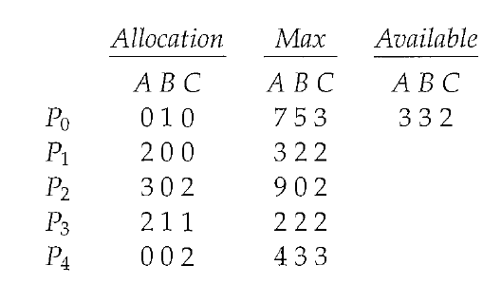
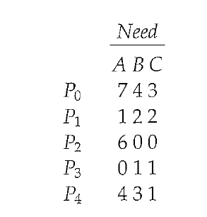
We claim that the system is currently in a safe state.
Indeed, the sequence < P1, P3, P4, P0, P2> satisfies the safety criteria.
Suppose now that process
P1 requests one additional instance of resource type A and two instances of
resource type C, so Request1 = (1,0,2). To decide whether this request can be
immediately granted, we first check that Request1 <= Available-that is, that
(1,0,2) <= (3,3,2), which is true. We then pretend that this request has been
fulfilled, and we arrive at the following new state:

Slide 13
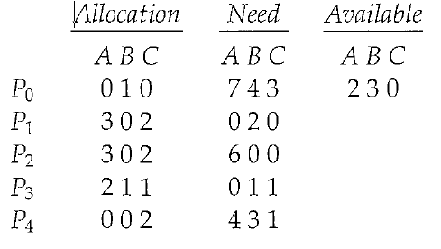
We must determine whether this new system state is safe. To do so, we
execute our safety algorithm and find that the sequence <P1, P3, P4, Po, P2>
satisfies the safety requirement. Hence, we can immediately grant the request
of process P1.

Slide 14
You should be able to see, however, that when the system is in this state, a request for
(3,3,0) by P4 cannot be granted, since the resources are not available.
Furthermore, a request for (0,2,0) by Po cannot be granted, even though the resources are
available, since the resulting state is unsafe.

Slide 15
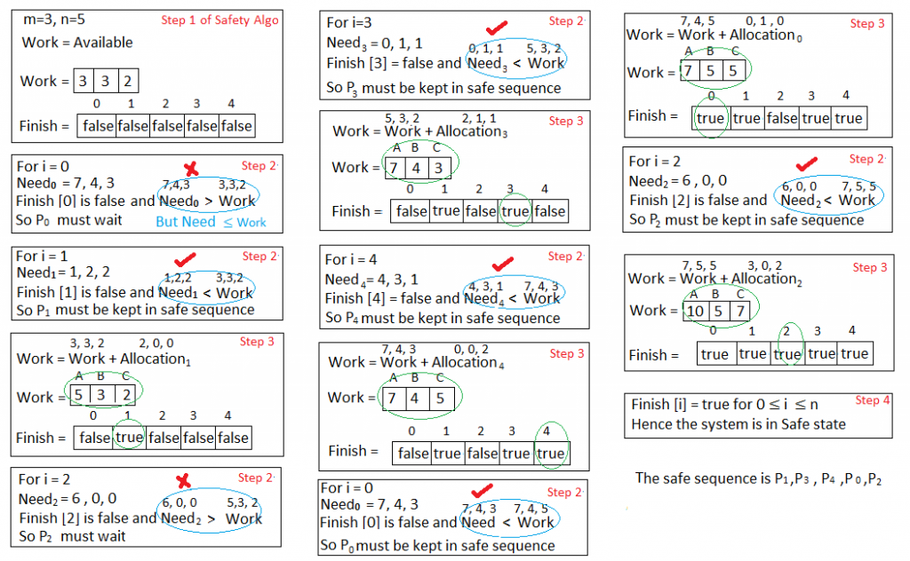

Slide 16
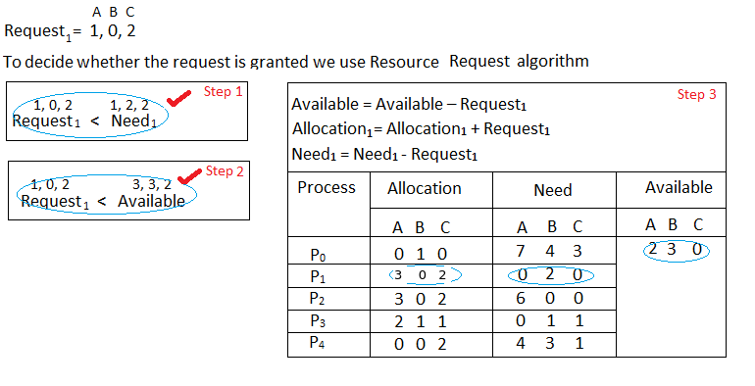

Slide 17
